Slide 1
Opening a Github Account
Rajesh Paul
Roll-12
17 DFTC BATCH

Slide 2
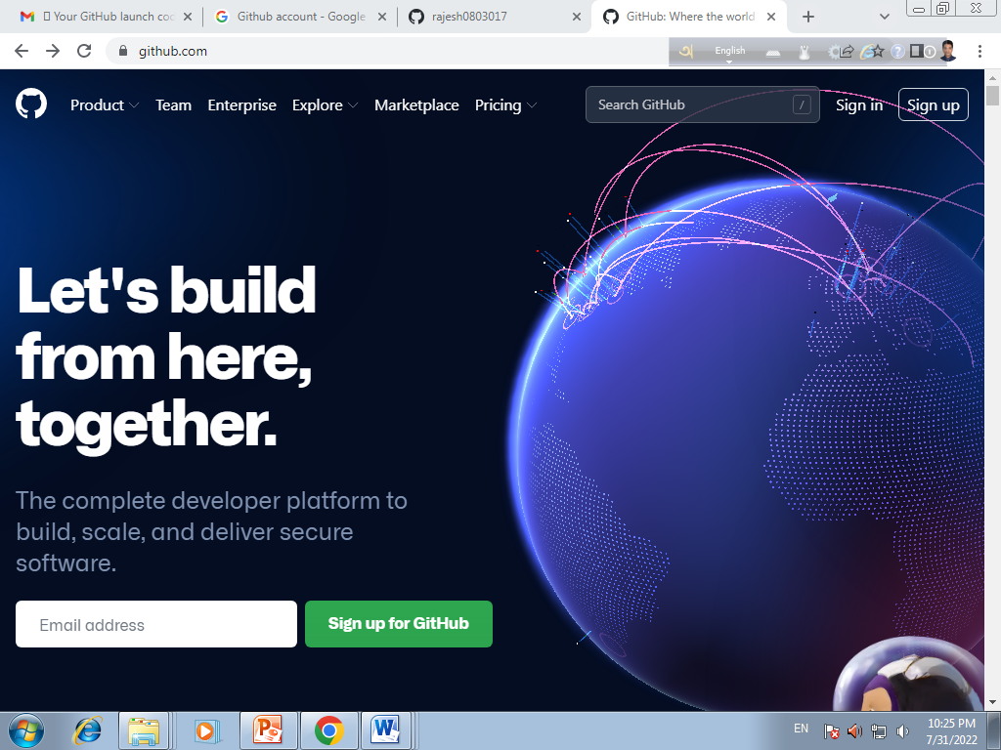
Sign Up Option

Slide 3
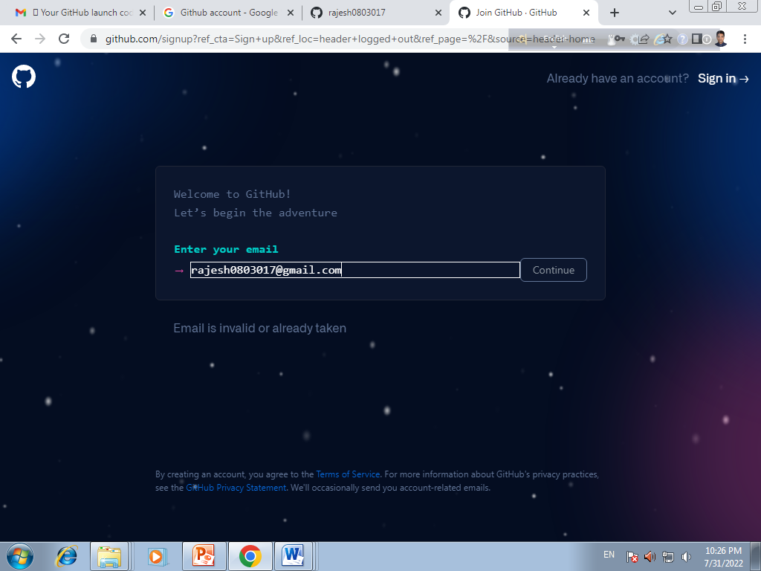
Enter Your Email

Slide 4
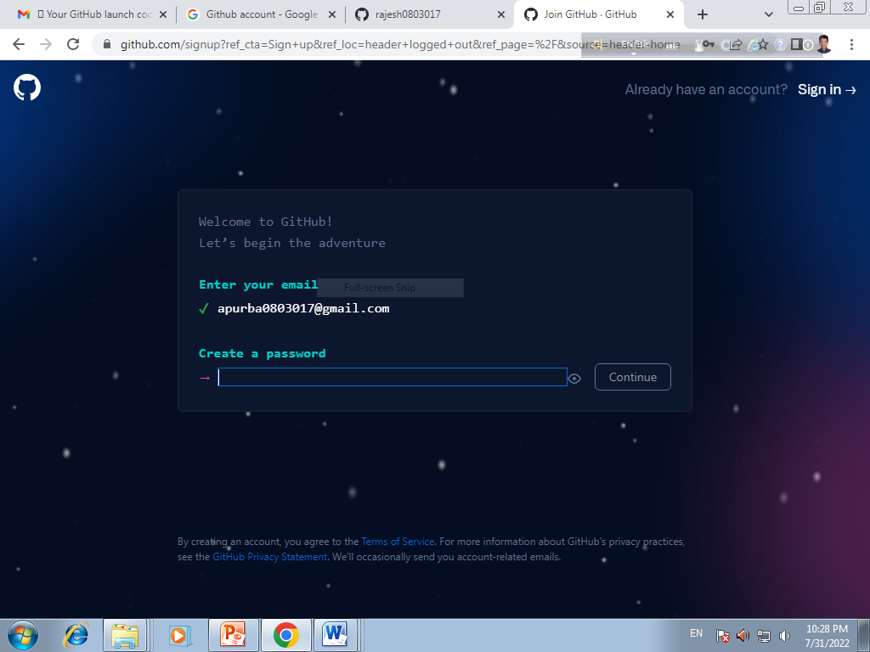
Create a password

Slide 5
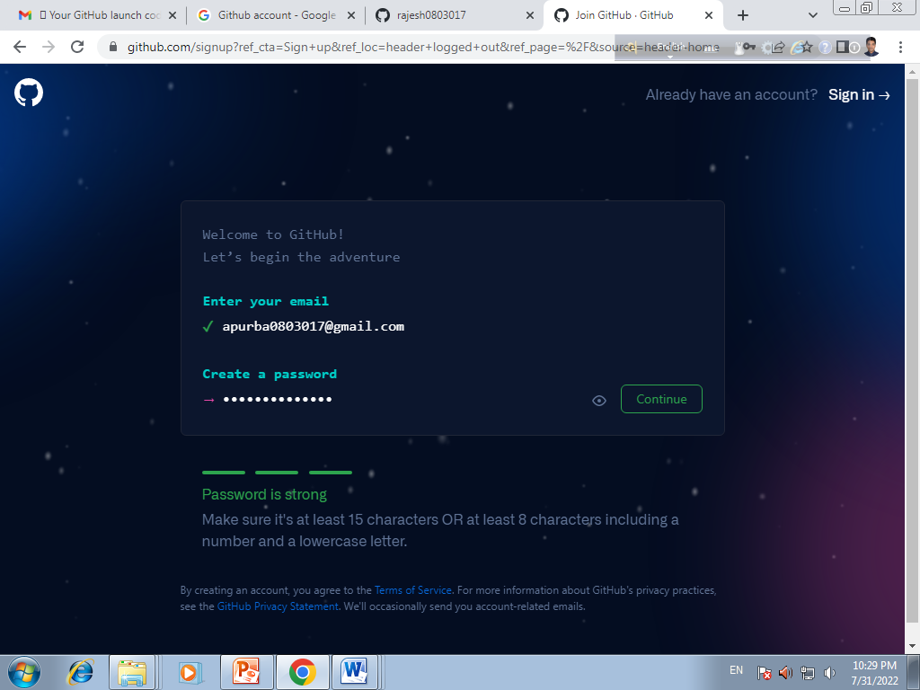
Password Acceptance

Slide 6
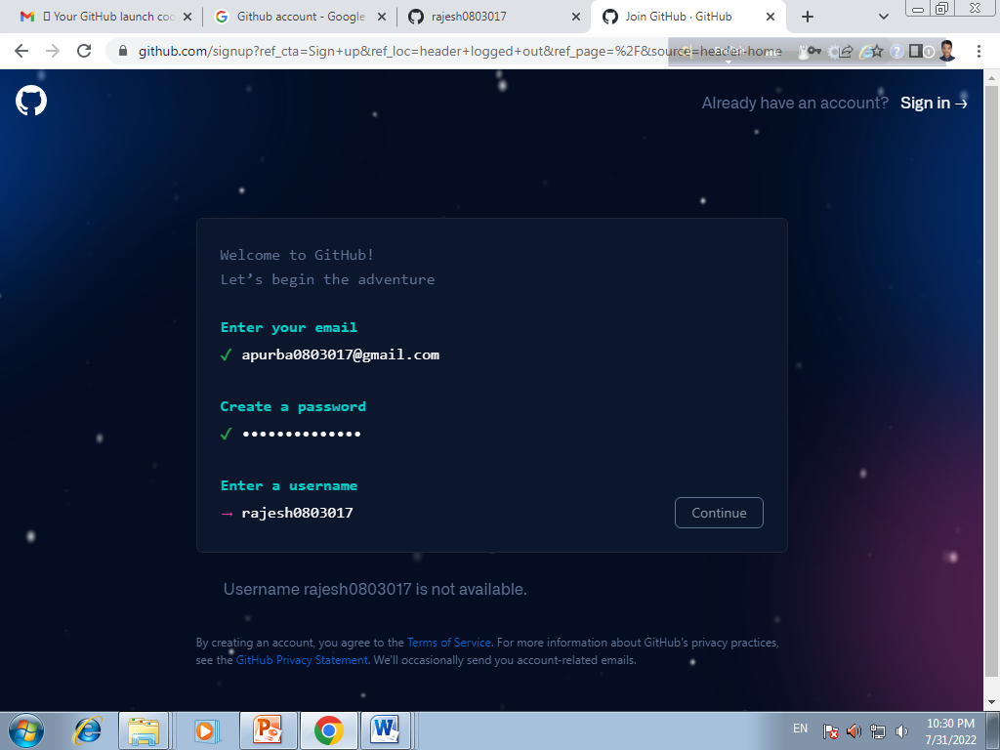
Enter User Name

Slide 8
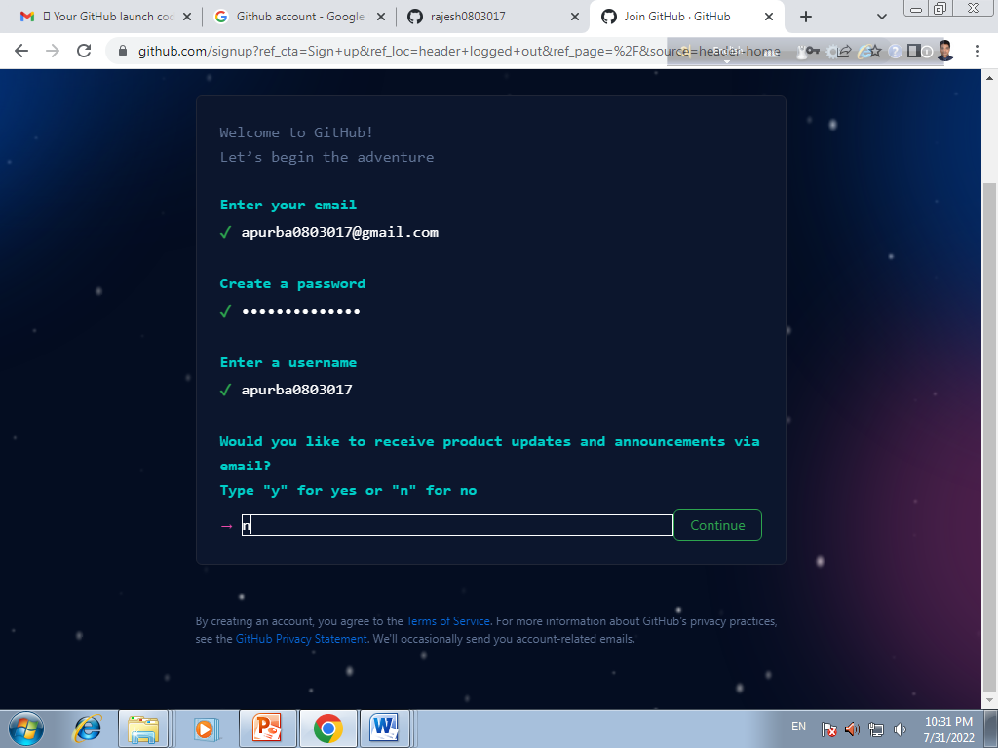
Answering a Question

Slide 9
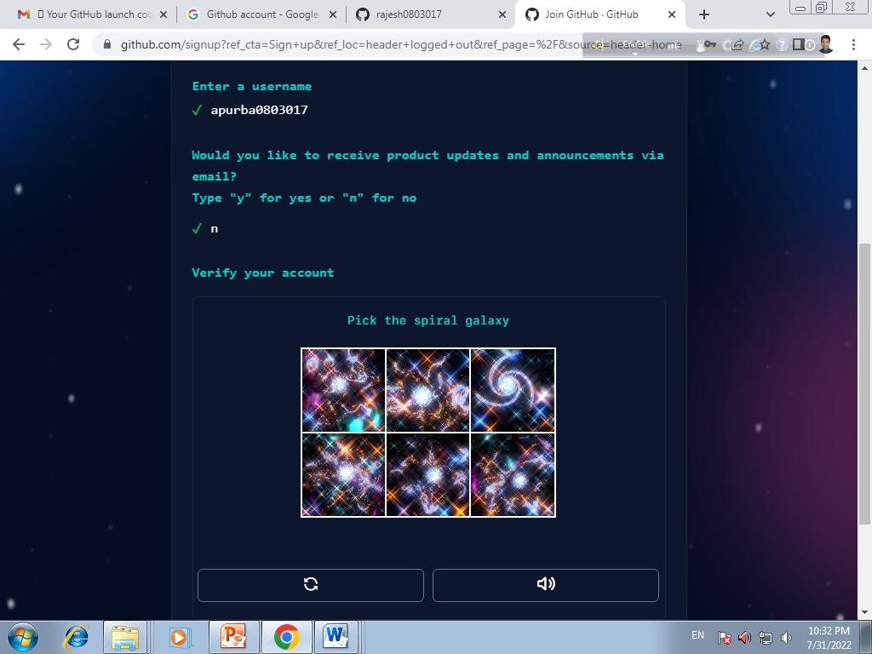
Solving Puzzle

Slide 10
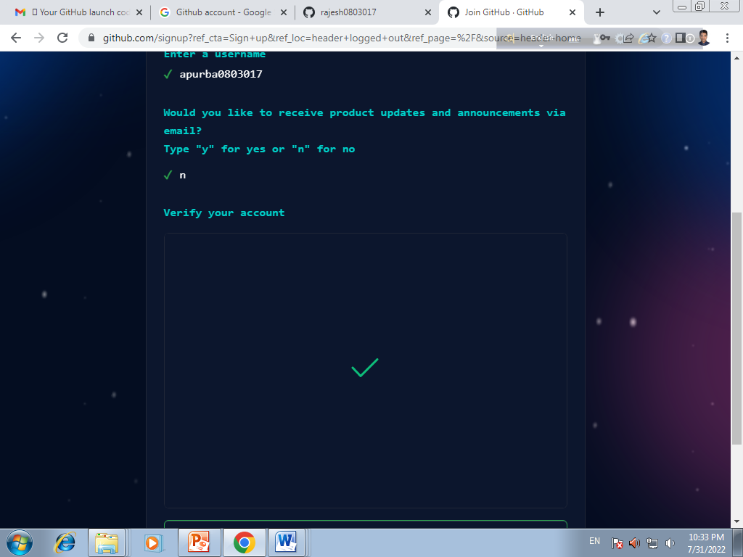
Verified Account

Slide 11
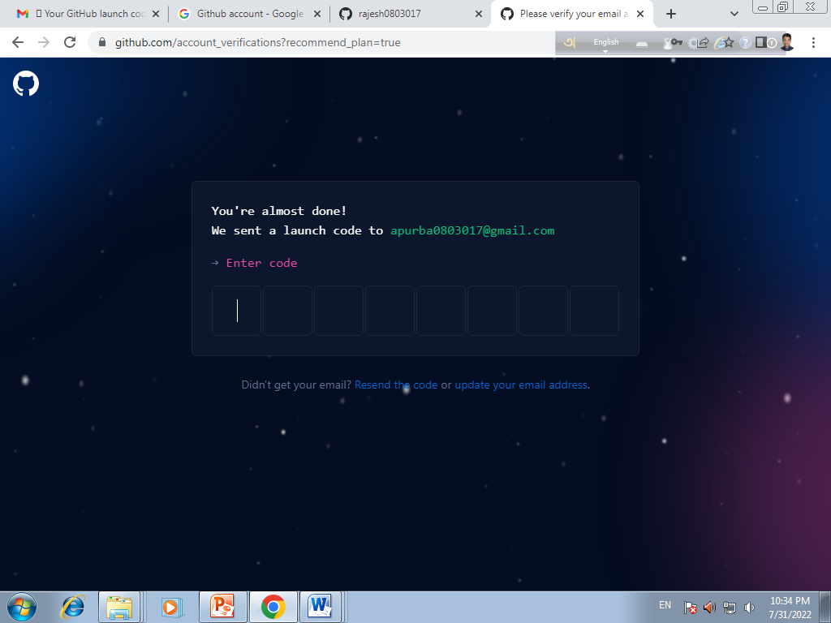
Enter Code

Slide 12
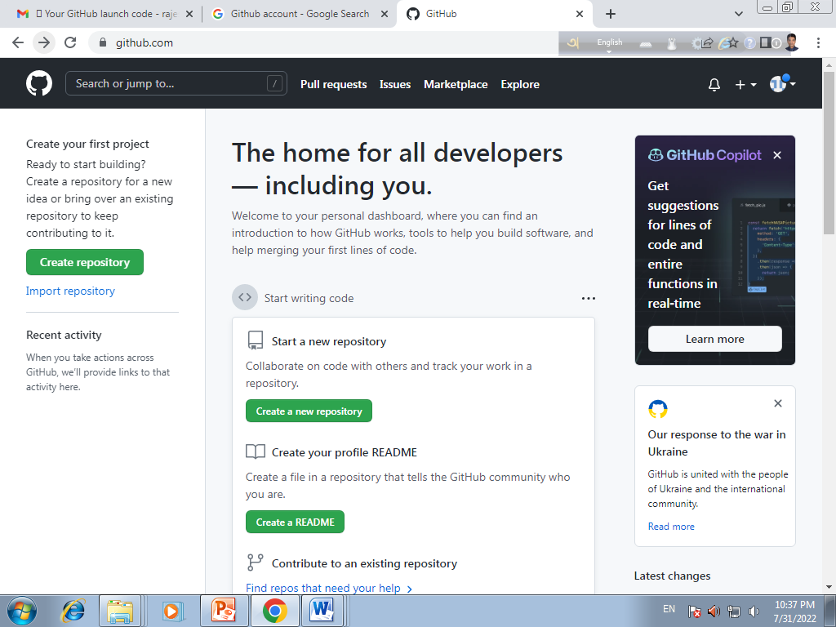
Create A Repository

Slide 13
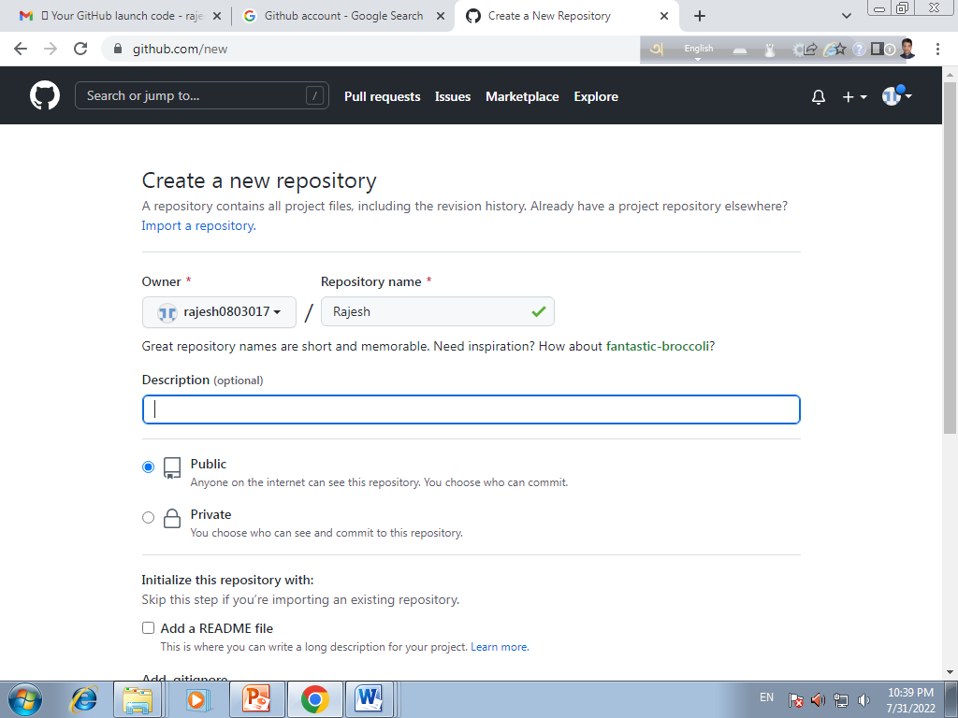
Create a New Repository

Slide 14
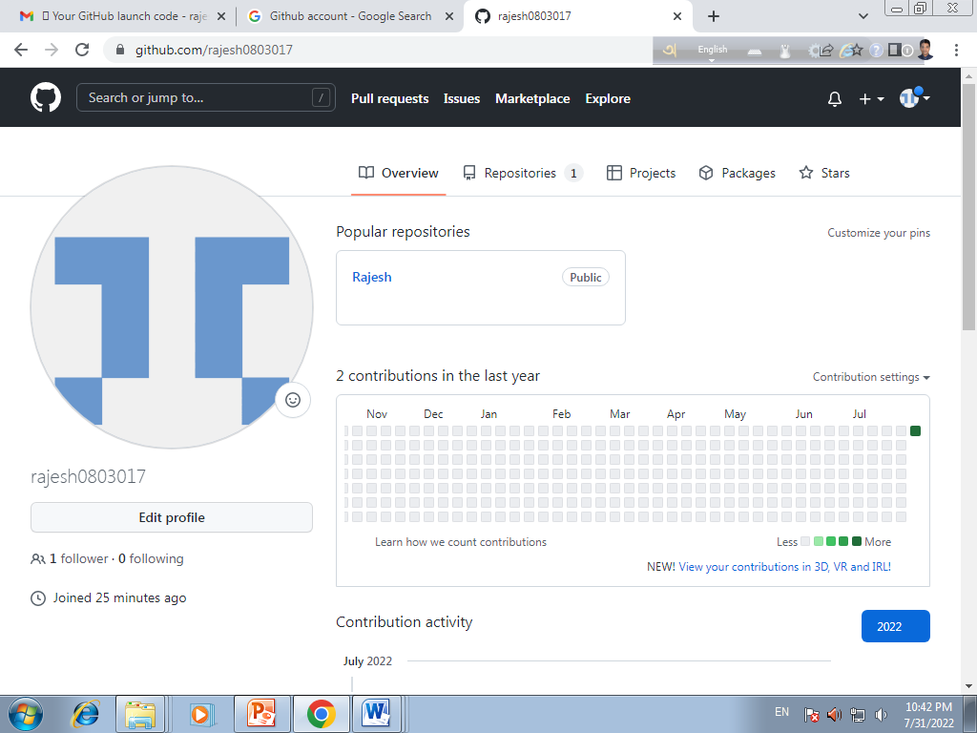
Check Profile

Slide 15
THANKS

